Slide 1
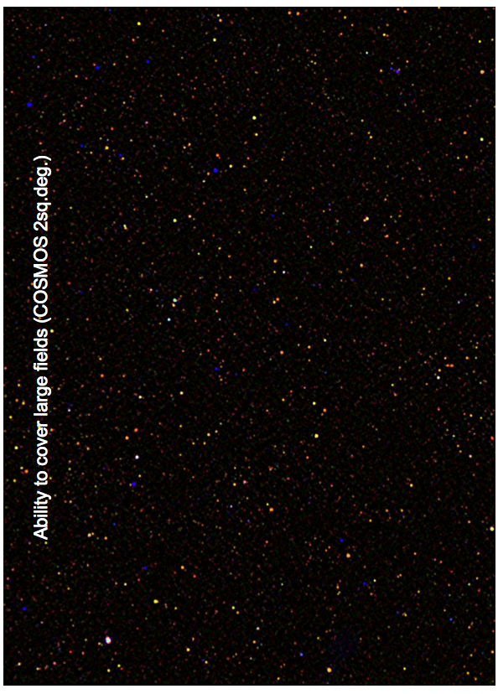

AGN surveys:
The MIR-FIR side
Francesca Pozzi
University of Bologna
Francesca Pozzi AGN10 meeting Roma 10-9-2012

Slide 2
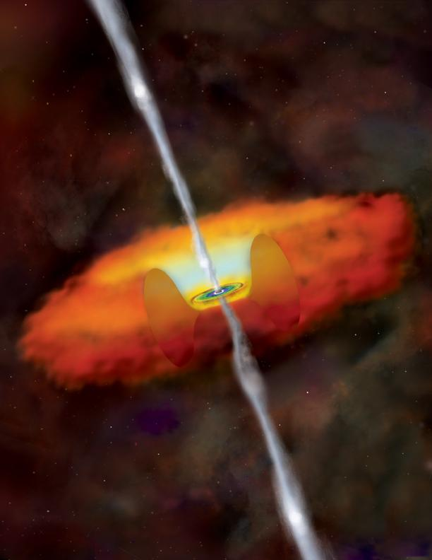
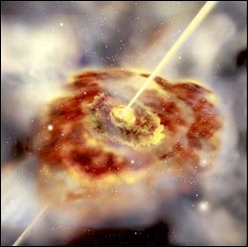
Structure of the talk
IR emission at nuclear/AGN scale
IR emission at galactic scale

Slide 3
Talk outline
The nuclear IR emission
Brief historical introduction
Theoretical predictions/ observational evidences
IR surveys
From the past up to Herschel
Key results from Herschel
Future IR satellite: SPICA

Slide 4
Part I: The nuclear IR emission

Slide 5
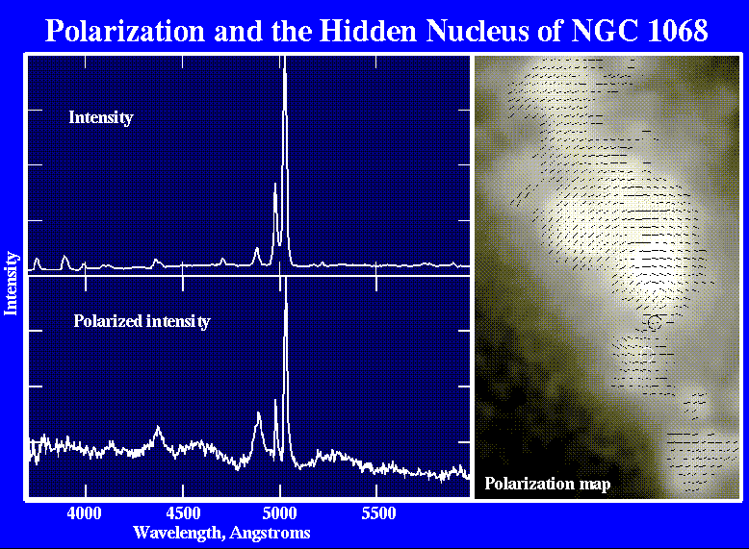
Part I: The nuclear emission
Indirect evidences
Antonucci & Miller (1985) Weak polarized light broad emission
lines hidden by strong
narrow lines in
Sey2 NGC1068 in
polarized light.
Capetti+ 1995

Slide 6
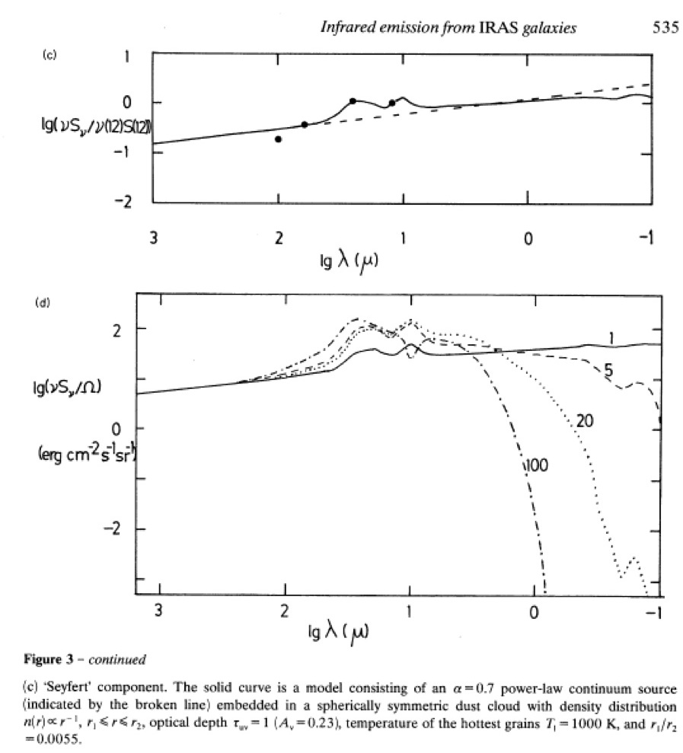
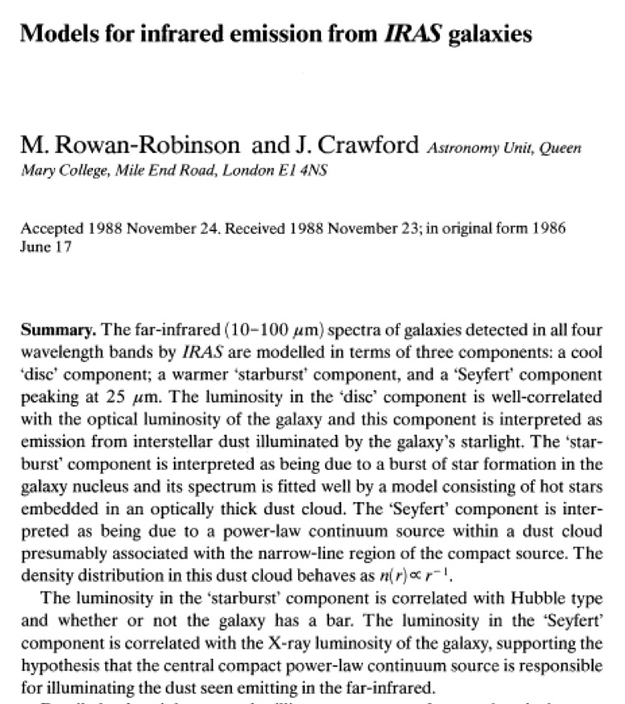
‘SED shape’
25 μm excess observed with IRAS (Miley+ 1984) modeled by Rowan-Robinson & Crawford (1989) as dust thermal emission

Slide 7
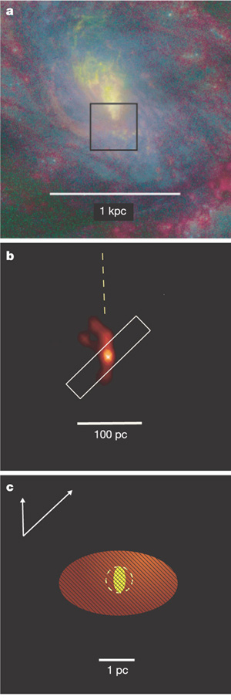
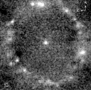
20 years after..
Imaging at MIR (8-13 μm)
The dusty torus exist !!!
NGC 1097 (Liner/Sey1) Gemini 11.7 μm MIR emission at pc (37 pc, torus ) and Kpc scale (starburst) Mason+ 07
NGC 1068 a) Optical image
b), c) VLT (MIDI) 8.7 μm data & model
Torus: 3 pc (two Temp. components)
Jaffe+ 04 Nature

Slide 8
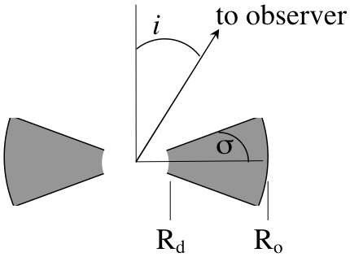
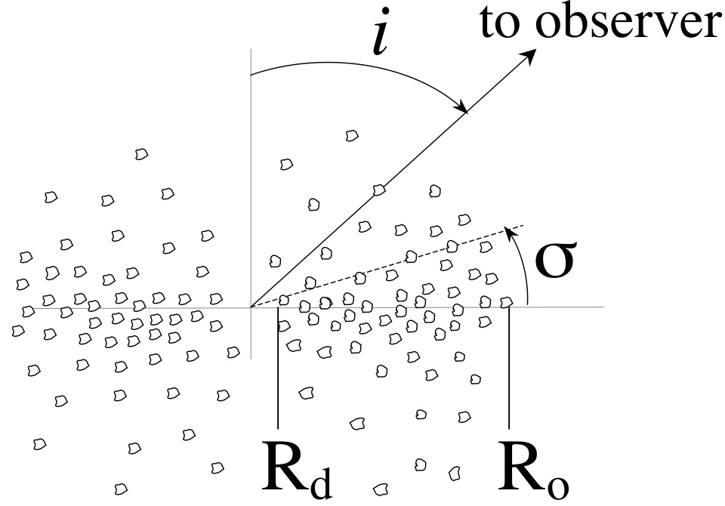
Part I: The nuclear emission modeling
Radiative transfer model : emission/scattering/absorption
30 years of modeling!!mo
Clumpy models
dust grains in clouds (not uniform distribution). A Type 2 AGN can be seen also at large inclination angles over the equatorial plane (e.g., Nenkova+02,08;
Nikutta+09; Hoenig+08, 0; Schartmann+08;
Smooth dust distribution
dust grains around a central source (AGN) in a smooth distribution (e.g., Pier & Krolik 92, Granato & Danese 94; Efstathiou & Rowan-Robinson 95, Fritz+ 06)
See A. Feltre’s talk for a detailed description of these modelings

Slide 9
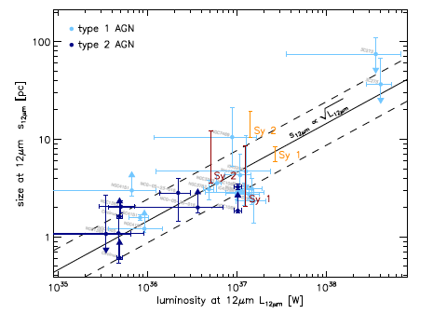
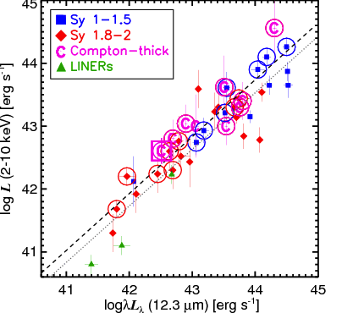
Indication from high-resolution mid-IR
Compact (a few pc) tori with a clumpy/filamentary
dust distribution (warm disk + geom. thick torus)
No significant Sey1/Sey2 difference
Tristram & Schartmann 2011
(see also Jaffe+04; Meisenheimer+07;
Tristram+07; Tristram+ 09)
Tristram & Schartmann 2011
(see also Jaffe+04; Meisenheimer+07;
Tristram+07; Tristram+ 09)
Tristram+07 - Circinus
VLT/VISIR Gandhi+09
Notes:
The irregular behaviour of the visibilities and the shallow decrease of the dust temperature with radius provide strong evidence for a clumpy or filamentary dust structure.
Because the sizes are plotted as a function of the luminosity at the same wavelength, the figure essentially represents a measure
for the compactness of the brightness distribution: any size deviating from the relation implies that the emission is either
more compact (size below the relation) or more extended (size above the relation) than the average dust distribution.
The ranges of sizes predicted by the models are shown by the thick bars in Fig. 3 . The ranges of sizes estimated from the
hydrodynamical torus model are plotted in orange, those from the clumpy torus model in dark red.
For the same mid-infrared luminosity, a Seyfert 1 torus thus appears about 2.5 times smaller than a Seyfert 2 torus. Its brightness
distribution appears more compact, because it is dominated by the bright emission from the hot dust at the inner rim of the
torus, i.e. it has a stronger flux concentration towards the centre of the brightness distribution.

Slide 10
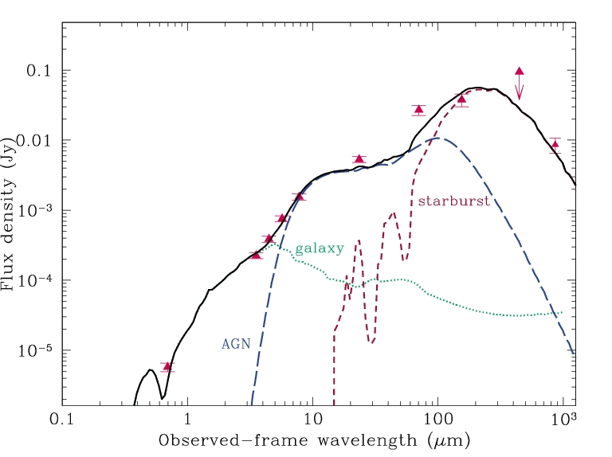
Torus exist but embedded in the galaxy that emits in the IR
IR surveys must take care of both
face on
τ (9.7) ≈1.0
covering angle≈140 deg
SFR≈1500 M/yr
≈54% is the AGN contribution to the 1-1000 μm
Vignali et al. (2009)
z~1.9
C X-ray AGN
edge on
edge on
Using MH03: M_{BH}≈1.9x10⁹ M
L_{bol}=4.3x10⁴⁶ erg/s
⇒ λ=Edd. ratio≈0.19

Slide 11
Part II: IR surveys

Slide 12
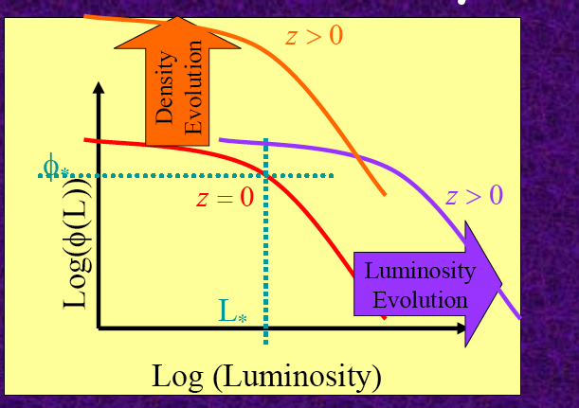
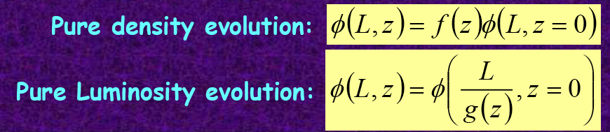
Part II: IR survey
Galaxy number density as a function of their luminosity @ different z
Taken from La Franca AGNIX
The real LF is likely more complex
IR mission μm Mirror [m] T (K)
IRAS 1983 Mid-Far 0.56 <6
ISO 1996 Mid-Far 0.60 <6
Spitzer 2003 Mid-Far 0.85 <6
Herschel 2009 Far 3.5 80
Spica 2020? Mid-Far 3.2 <6

Slide 13
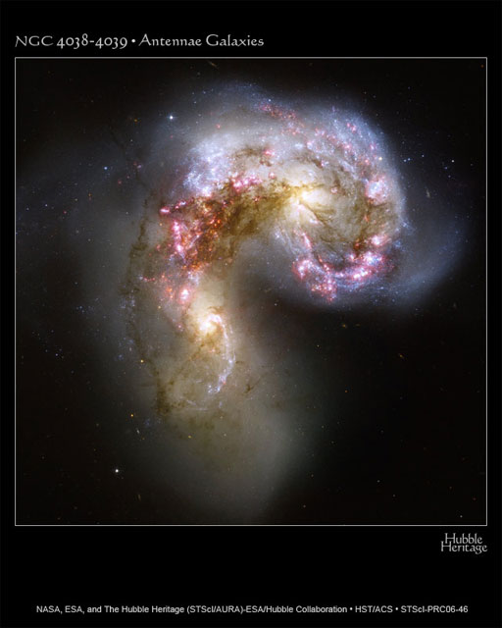
IRAS survey (1983)
IRAS explored z<0.2 discovered a new class of galaxies : ULIGs
(i.e. Soifer+ 87). Hosting an AGN?

Slide 14
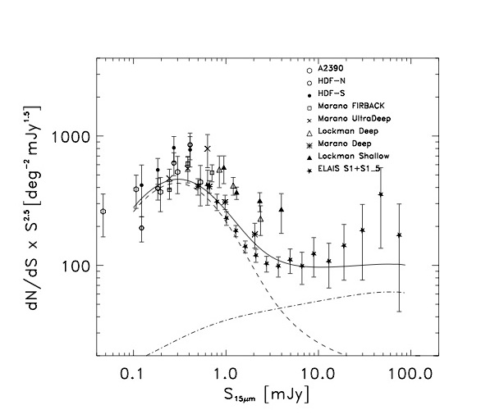
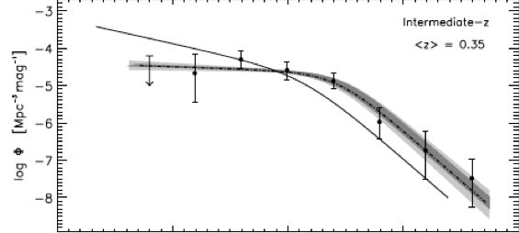
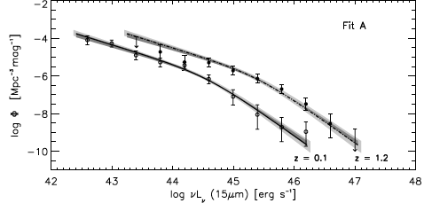
ISO survey (1996)
Cosmological survey @ 15μm z~1.5 Strong evolution.
➔ Fast-evolving (~(1+z)⁴ ) starburst galaxy dominated counts (Franceschini+01,Elbaz+02, Pozzi+04)
Contribution of optical AGNs
<20 %
AGN1: L(z)=L(0)(1+z)^{2.9}
AGN2: L(z)=L(0)(1+z)^{1.8-2.6}
Pozzi, Gruppioni, Oliver+ 04
Matute, La Franca, FP+ 06

Slide 15
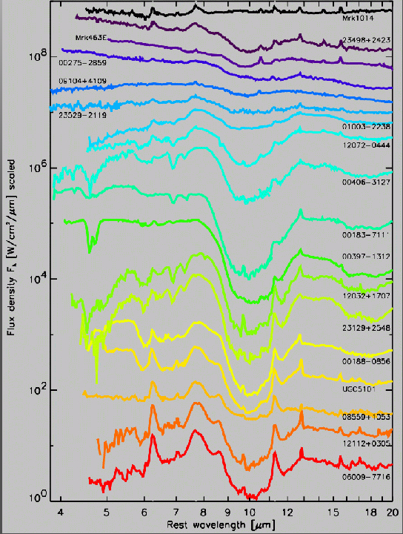
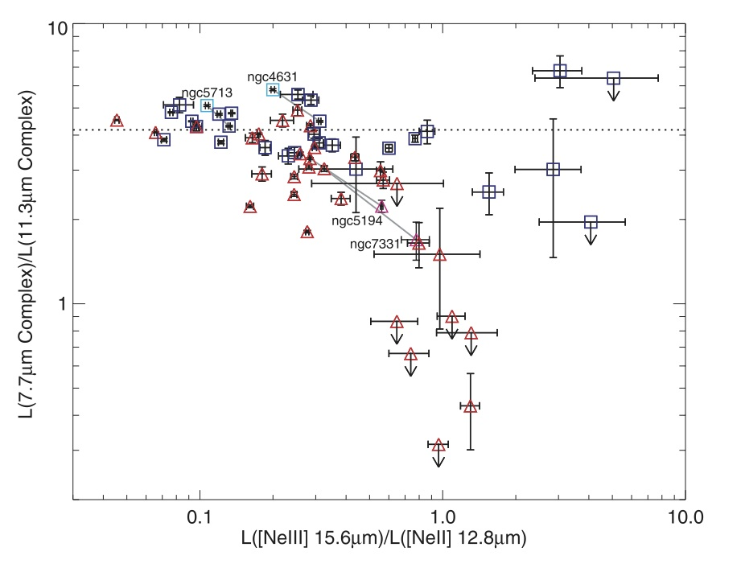
Spitzer survey (2003)
Selection of AGN IRS (5-38μm)
➔~50% of local galaxies harbour a low-L AGN from PAH strength (larger PAH grains (11.3) destroed by AGN field)
Charmandaris+ 04
Lacy+04 selection
AGN
Smith+ 07

Slide 16
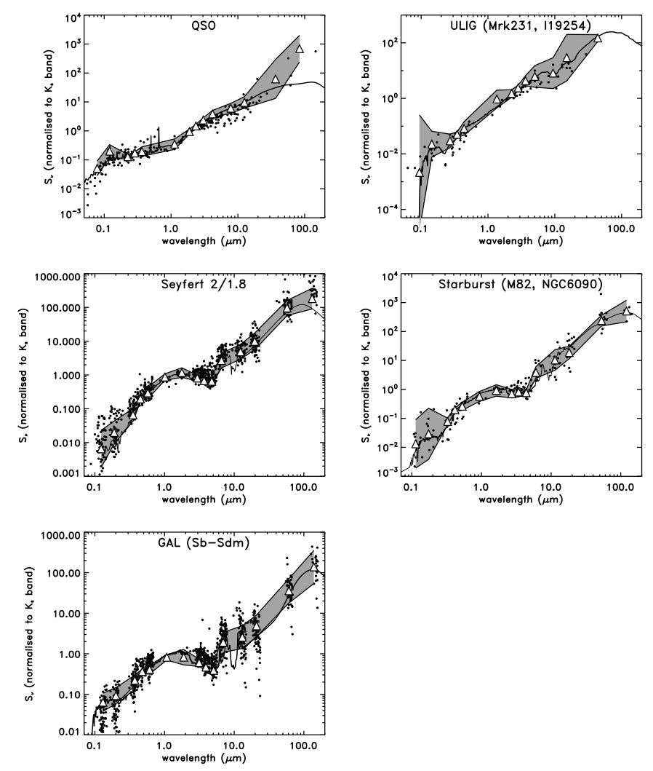
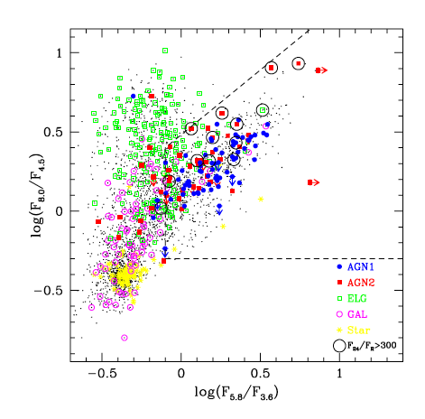
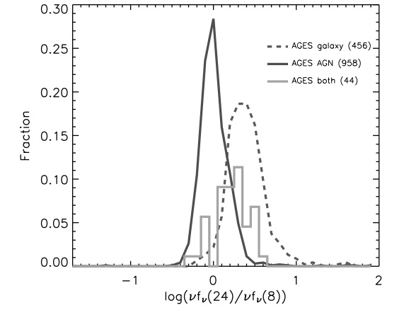
Selection of AGN from IRAC colours & SED
Galaxy
Torus
IRAC
24μm
Blue
Lacy et al. 2005
Lacy+04
Gruppioni, FP+ 08
Sacchi+ 09 see also Donley+12)
Brand+ 06

Slide 17
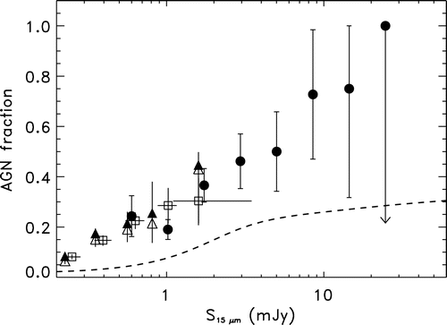
Galaxy with AGN in MIR selected survey
~20 % (optical spectra) ➔ ~50 % (IRS & SED)
SED-selection (Gruppioni 08)
MIR selection (Brand 06)
X-ray det. & models (Treister 06)
Optical spec. class
(Matute et al. 06.)
53 %
Gruppioni, FP+08

Slide 18
Herschel survey (2009)
I) H-ATLAS - The Astrophysical Teraherz Large Area Survey
PI: S. Eales (Cardiff)
The Herschel ATLAS is a key legacy survey of 550 deg² covering 5 bands with PACS and SPIRE (110 – 500 microns)
II) HERMES - Herschel Multi-Tiered Extragalactic Survey PI: S. Oliver (Sussex) ~75 deg²
III) PACS Evolutionary Probe - PEP
PI: D.Lutz (MPE) ~ 4 deg²
I ) Accurate SED de-composition
in specific sample
Key results
II) AGN/starburst
co-evolution from statistical analysis
X-ray vs. SED selected AGN

Slide 19
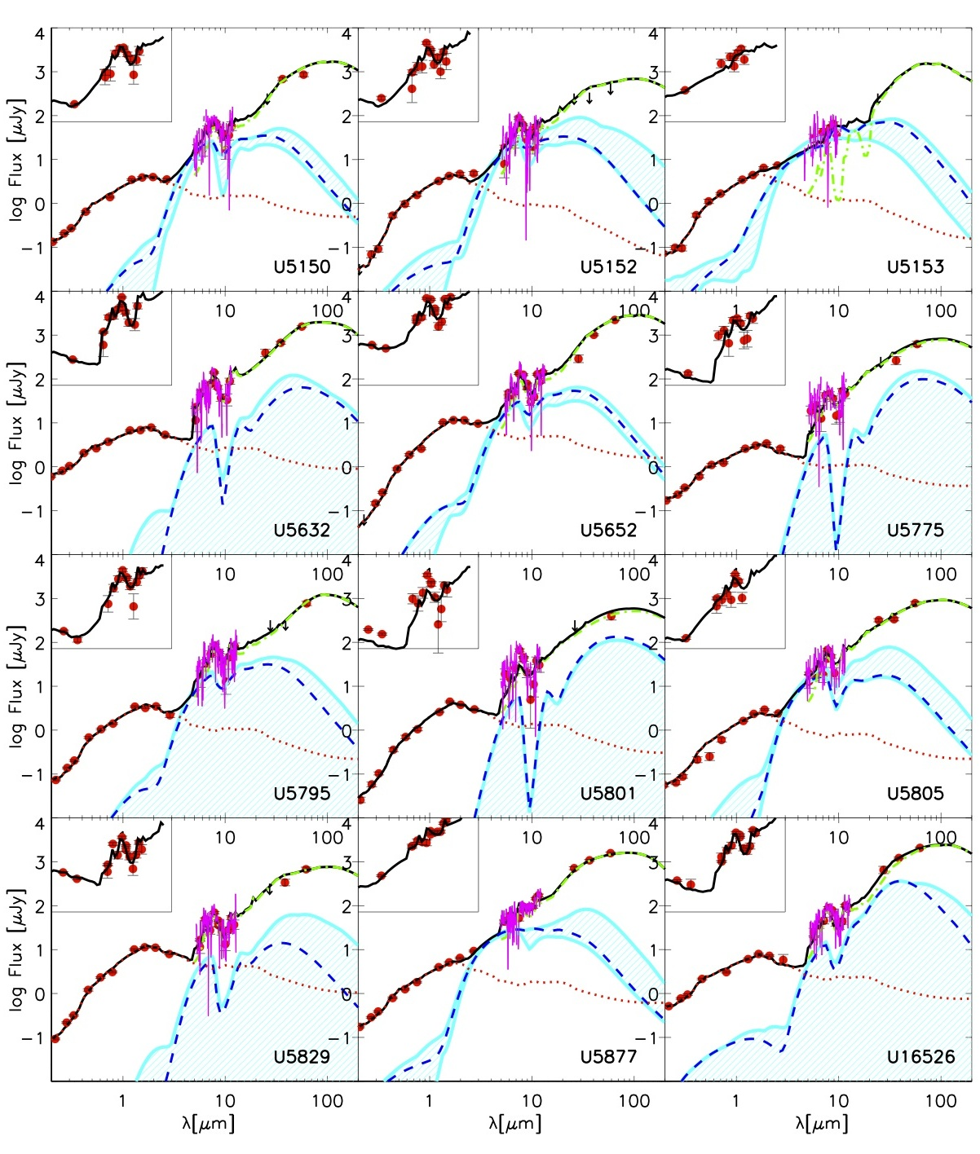
Herschel survey I: SED de-composition
PEP survey
24 ULIRGs (10¹² L), z~2
IRS + SED-fitting
35 % harbour AGN (3σ)
(<10% dominated AGN)
Z~0, Risaliti+10, with L-band obs ~60 % harbour AGN
Pozzi, Vignali+12

Slide 20
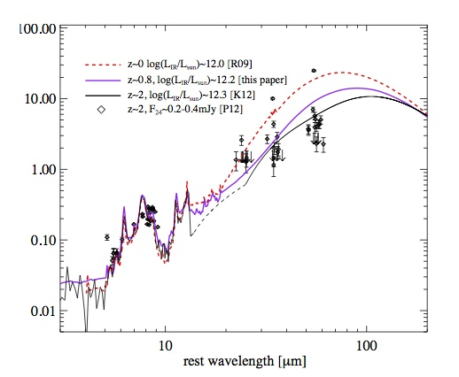
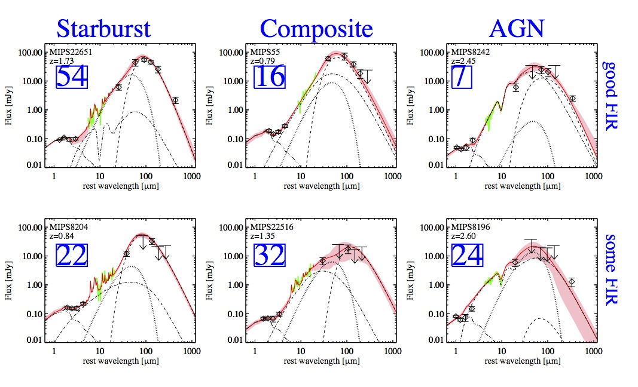
HERMES survey
~ 200 sources, L_{IR}~ 10¹¹- 10¹³ L
0.3< z<3.0
SED+IRS
Pozzi+12
53 % harbour AGN
23% AGN dominated
30 % composite
SED ULIRG high-z (z>2)
FIR/MIR low
(➔merger less
important at high-z)
Sajiina + 12

Slide 21
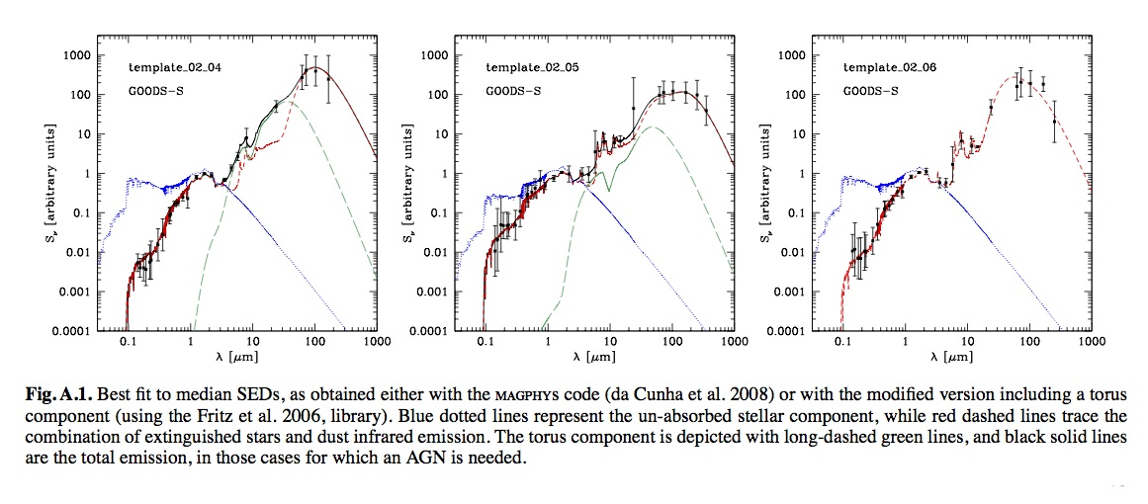
PEP survey
New SED library from data.
Reproduced by : Galaxy (MAGPHYS software ➔energy balance)
AGN (Fritz+06)
I) PEP survey
24 ULIRGs (10¹² L), z~2
IRS + SED-fitting
Berta +12, in prep.

Slide 22
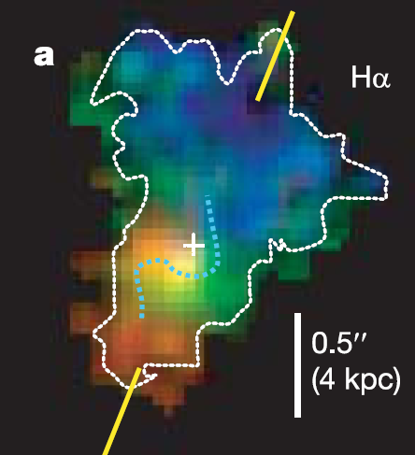
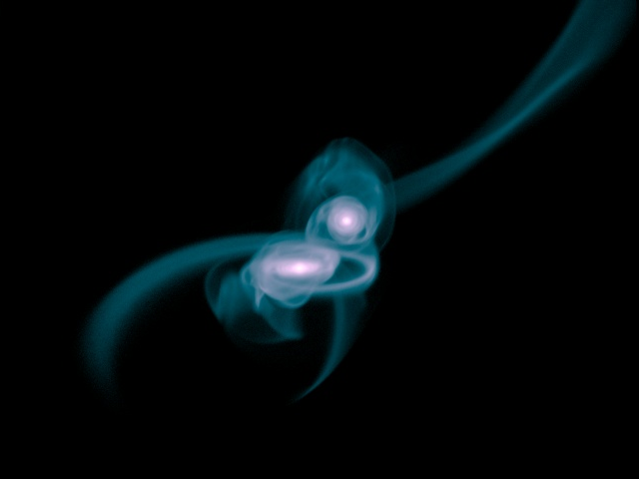
Herschel survey II AGN-galaxy co-evolution
Genzel+06,08
violent, major merger induced
scenario, short timescale (a few dynamical times)
~ “secular” smooth evolution:
gas inflow, disk instabilities,
minor mergers, long timescale
0.5 Gyr -> a few Gyr
Correlation M_{BH}-SFR
No correlation M_{BH}-SFR

Slide 23
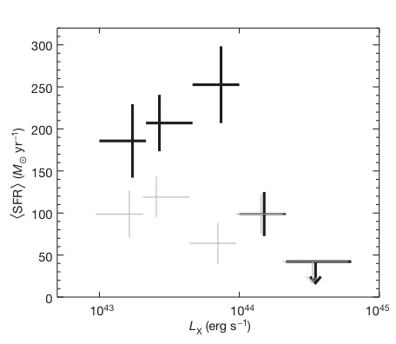
X-ray selected AGN
HERMES survey
Sample: CDF-N, 176 AGN
1<z<3 ➔ Suppression of SFR in host galaxy of powerful AGN Quasar-feedback
1<z<3
Stacked+detected 250μm
Only stacked
Page+ 12, Nature

Slide 24
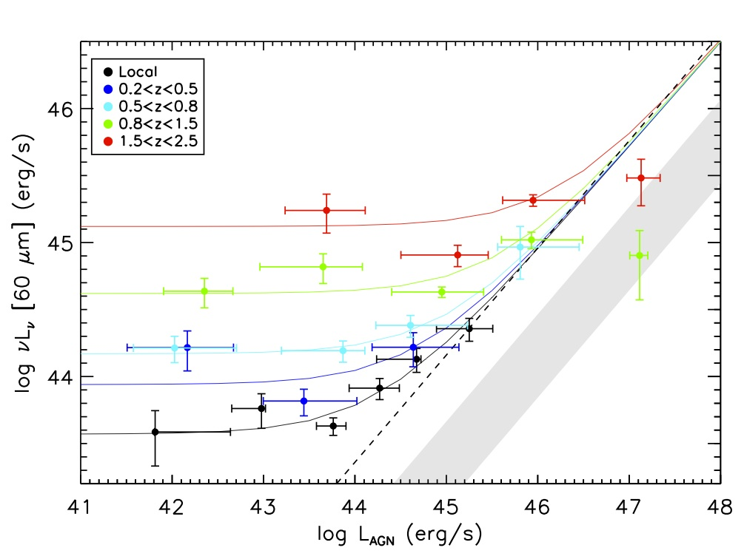
X-ray selected AGN
PEP survey
Sample: CDF-N, CDF-S, COSMOS
High-L AGN
z<1.5 correlation BH acc. and SFR ➔ Major mergers
Z> 1.5 no correlation BH acc. and SFR ➔ Secular (i.e Page.)
Low-L AGN
No correlation BH acc. & SFR (secular regime)
Rosario+12 (Shao+10)

Slide 25
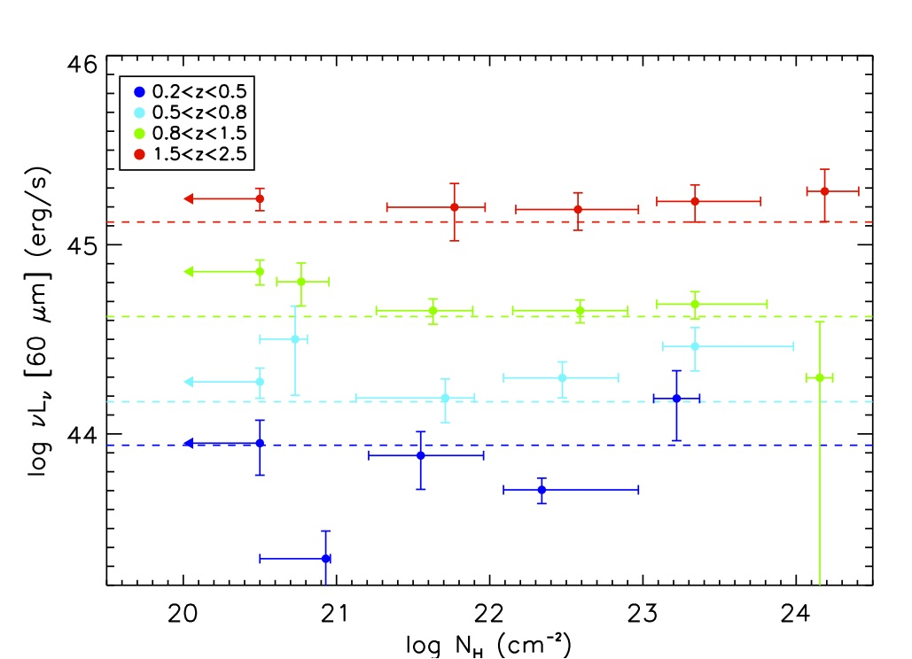
No correlation between L₆₀ (i.e. SFR) and N_{H}
➔ Gas and dust rich mergers do not account for most AGN at all z
Rosario+12

Slide 26
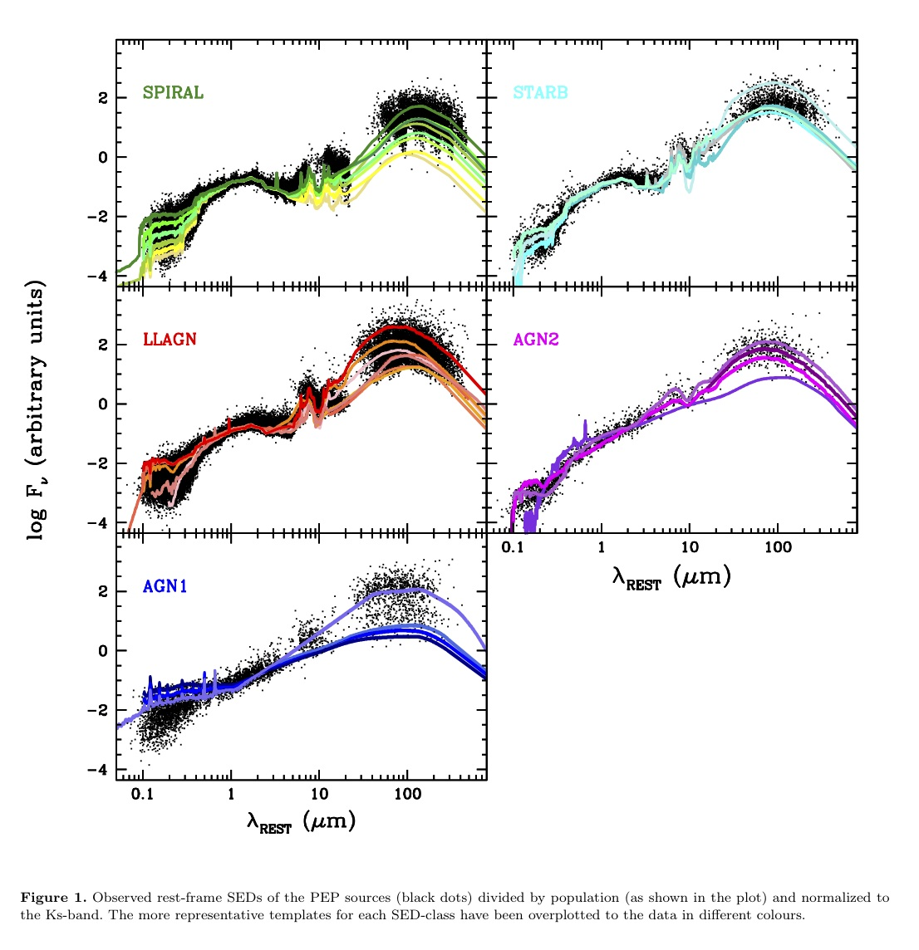
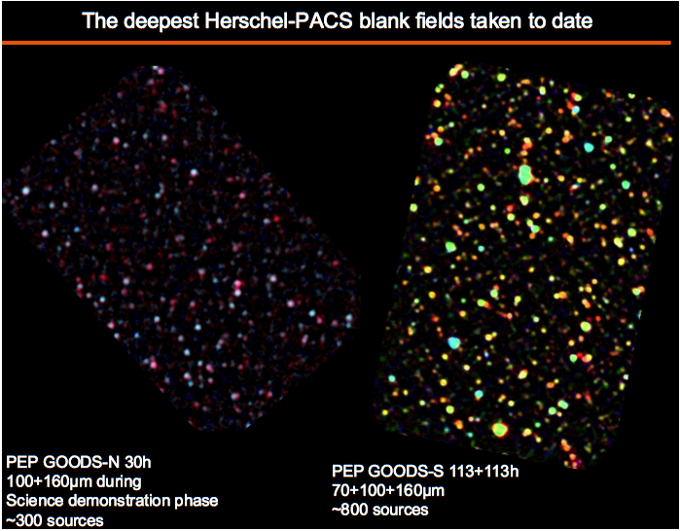
SED-fitting selected AGN
5 SED CLASS
PEP survey
IR Luminosity function of sources
divided by spectral class
PEP FIELDS
Gruppioni, FP, in prep.

Slide 27
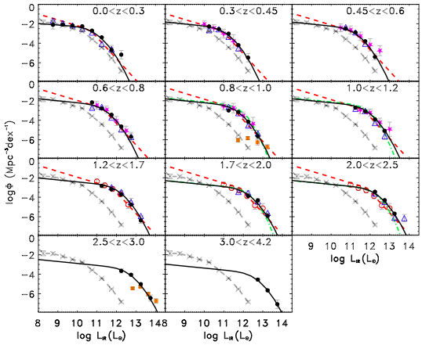
SED-fitting selected AGN
3<z<4 : first time
z<2.5 agreement Spitzer-based LF
Strong evolution
Gruppioni, FP, prep.
X ---------- Saunder+ 03
sub-mm Chapman+ 05
24 μm Le Flock+ 05
24 μm Magnelli 09, 11
24 μm Rodighiero 11
24 μm Caputi 07
This work
Spitzer (Le Flock 05)
Spitzer (Caputi 07)
○ Spitzer (Magnelli 11)
Spitzer(Rodighiero 11)
Gruppioni, FP+ in prep.

Slide 28
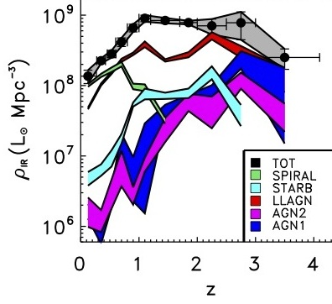
LLAGN dominate ρ_{IR} at z~1-2
LLAGN
Open issues
Real ?
Seyferts or ADAF ?
‘Secular’ mode?
X-ray detection
GOODS-N,
only 25% det.
logLx~43
X-ray stacking
in progress.
See I. Del Vecchio talk
Indication of λ_{EDD}< 0.01
Gruppioni, FP+ in prep.

Slide 29
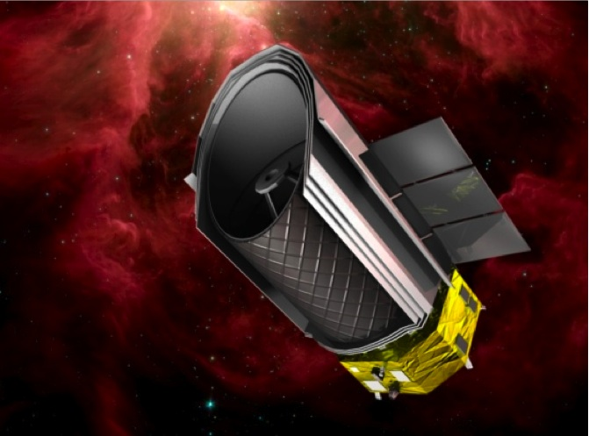
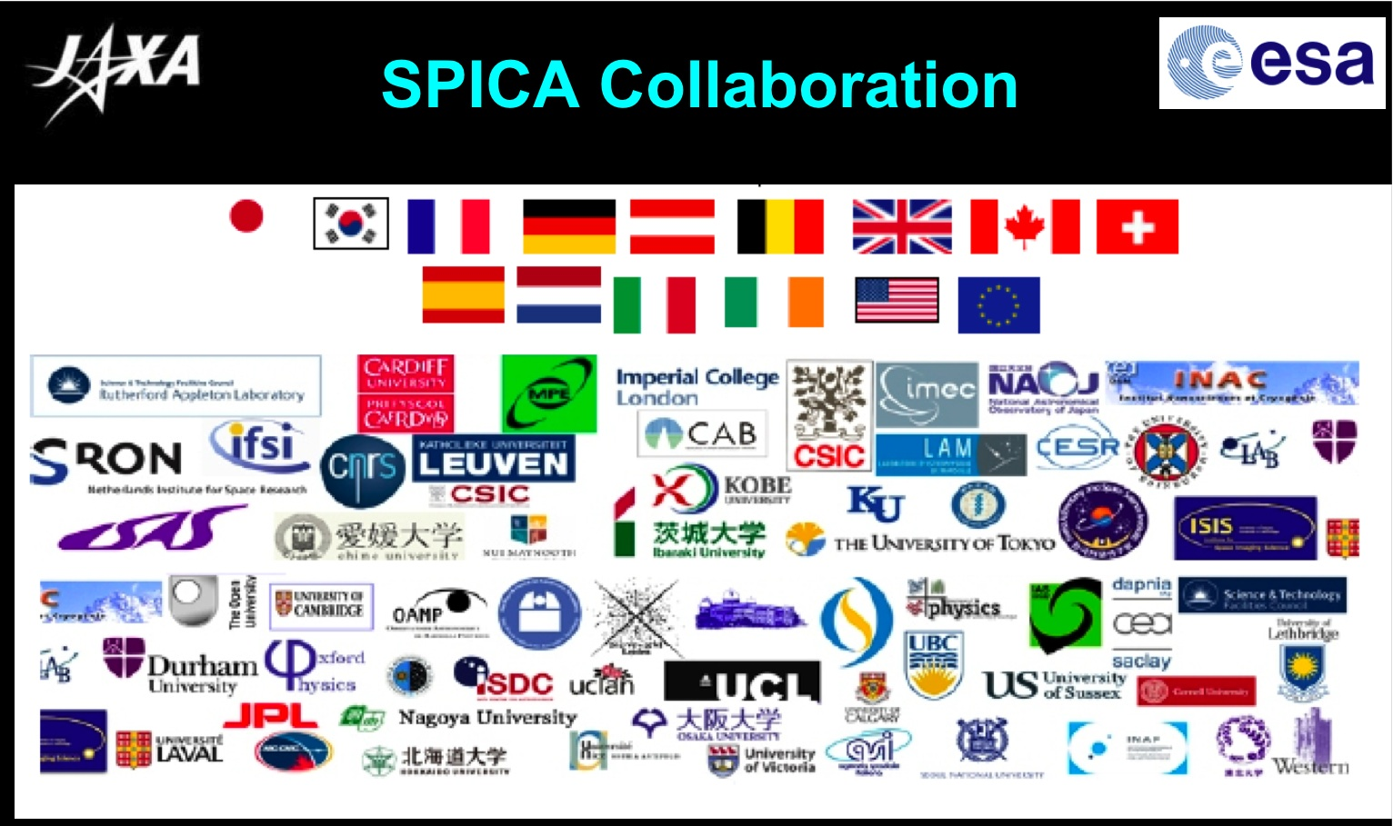
Future IR survey
SPICA satellite
Jaxa satellite
Date: early 2020
3.2 m, T< 6 K (HERSCHEL 80K)
Band: 30-210 μm
Ja

Slide 30
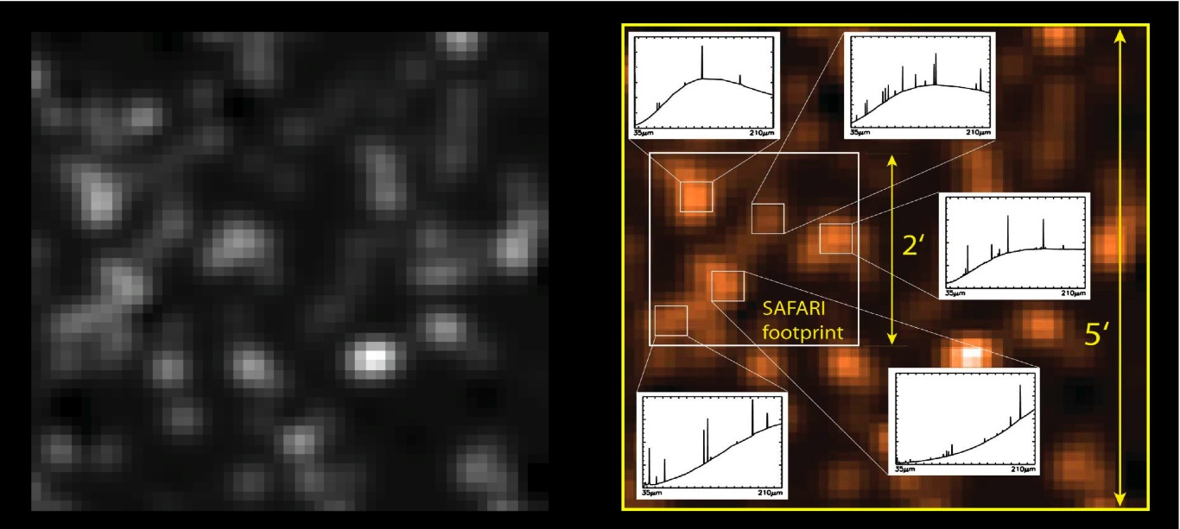
SPICA-SAFARI
Selected by ESA as ‘Mission of Opportunity’ in Cosmic Vision
FIR instrument
Camera & FTS spectrometer
Led by SRON (PI: P. Roelfsema)
Italian coordinator: L. Spinoglio
35-210 μm
Istantaneous coverage of the full spectum
λ/∆ λ = 3 (continuum)
= 50 (SED mode)
= 2000 (spectroscopy)
from yellow book, 2011

Slide 31
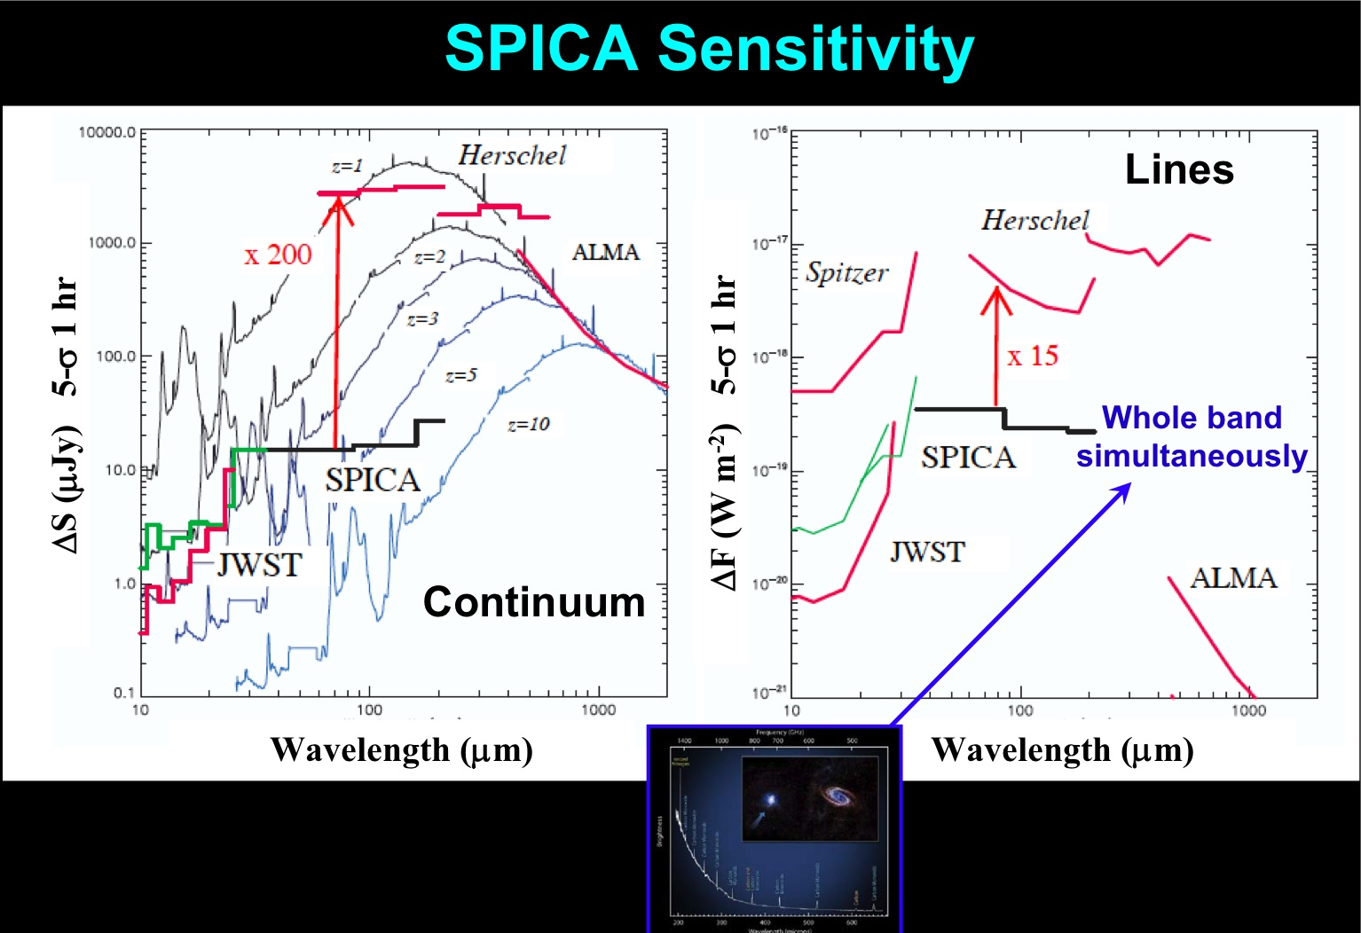
from yellow book, 2011

Slide 32
Summary
Importance of multi-band observations for a complete census of AGN.
Spitzer & Herschel observations suggest that ~50% of galaxies harbour an AGN.
Mainly ADAF?
Current Herschel observations suggest two different modes of BH-galaxy co-evolution,
‘The secular mode’ is the dominant?
The future SPICA satellite

